Slide 1

In Depth Analysis Of Company Revenue
Python Project using pandas and matplotlib
Presented By- Kanishka Salvi

Slide 2


Vision
Mission
To pioneer a data-driven approach in analyzing financial metrics, empowering organizations to unlock hidden opportunities, drive sustainable growth, and foster informed decision-making.
Our mission is to conduct a thorough analysis of financial datasets, utilizing advanced data processing techniques and insightful visualization methods. By providing comprehensive insights into sales and profit trends, we aim to equip businesses with the knowledge needed to optimize performance, identify strategic opportunities, and navigate market complexities with confidence and clarity.

Slide 3

The dataset utilized in this project comprises crucial information regarding the company's sales and profit metrics, segmented by market categories and geographical regions.
These insights serve as the cornerstone for assessing the company's performance, pinpointing avenues for growth, and facilitating data-driven decision-making.

Slide 4

The primary objectives of this project are as follows:
Data Pre-processing: Conduct comprehensive data pre-processing to ensure data accuracy and reliability.
Exploratory Data Analysis (EDA): Uncover meaningful insights through exploratory data analysis, shedding light on sales and profit trends.
Visualization: Employ data visualization techniques to present sales and profit trends over time, enabling stakeholders to grasp key patterns and make informed decisions.
Recommendations: Provide actionable recommendations and key takeaways derived from the analysis to drive organizational success.

Slide 5


Column Names Verification: Begin by scrutinizing column names to ensure consistency and accuracy in data representation.
2.Special Character Removal: Eliminate special characters such as "$" or "-", as they can impede numerical operations and distort data analysis results.
3.Data Type Conversion: Convert data types from object to numeric (integers or floats) as necessary to facilitate mathematical operations and visualization.
Challenge: Removing Commas: As a challenge, strive to remove commas from numerical values. This step is crucial for mitigating data type inconsistencies and ensuring accurate numerical analysis.

Slide 6

Exploratory Data Analysis
Exploratory Data Analysis (EDA) serves as a cornerstone in extracting actionable insights from the dataset. By visualizing sales and profit trends over time, this analysis aims to uncover patterns, identify areas for improvement, and support strategic decision-making.

Slide 7
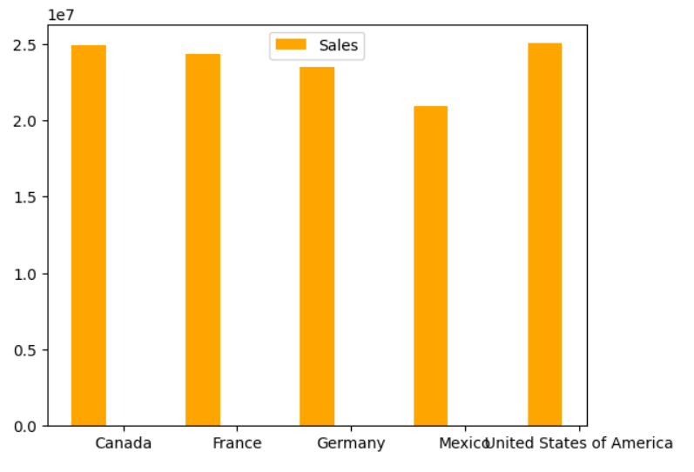
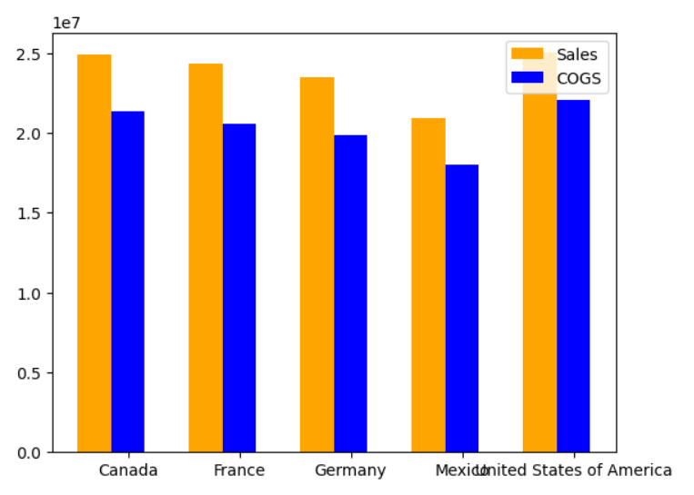
Country wise Analysis
We can see that highest sale is noticed in USA and in Canada and lowest sale is recorded in Mexico
We can see that Sales is more than the COGS(Cost of Gross Sale) it means company is in profit

Slide 8
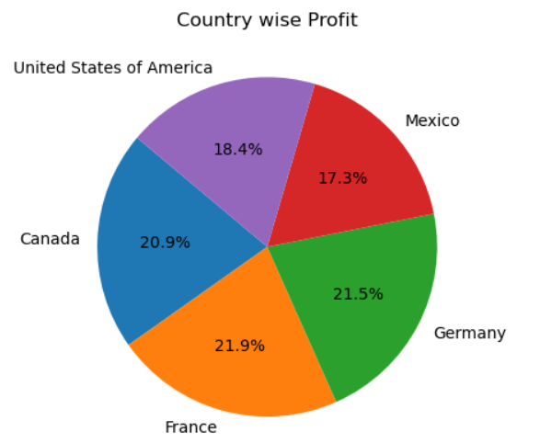
Country Wise Analysis
We can see that highest Profit is noticed in France and Germany and lowest sale is recorded in USA

Slide 9
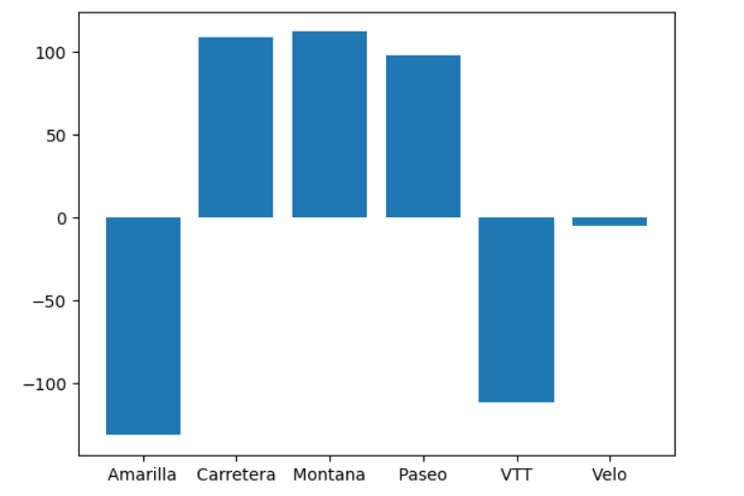
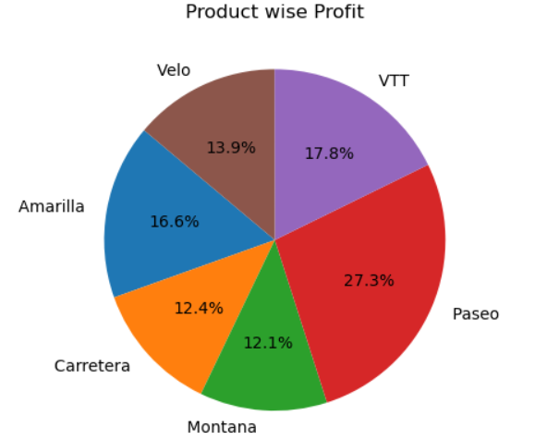
Product Wise Analysis
From above figure we can see that Product 'Amarilla' and product 'VTT' has negative gross margin and product 'Velo' has very low margin
From here we can see that Paseo has highest profit and Montana have low profit

Slide 10
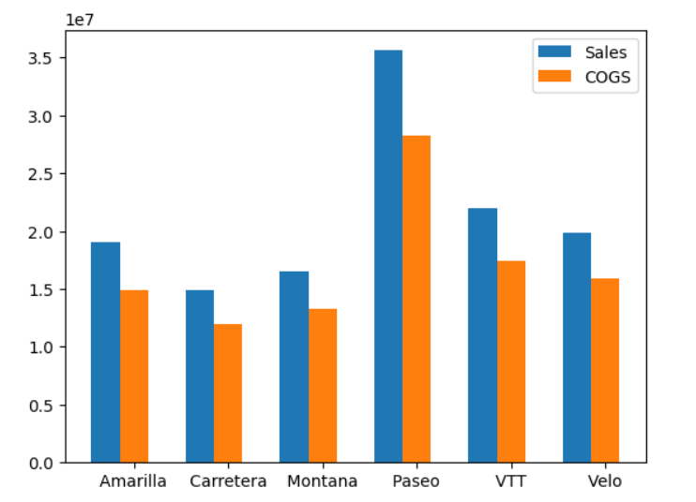
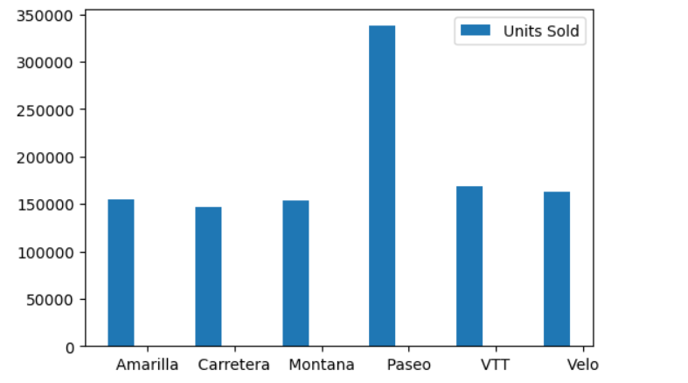
Product Wise Analysis
From here we can clearly see that Paseo is the product which sells maximum
Sales of Paseo is much more than other Products and Carretera has the low sales

Slide 11
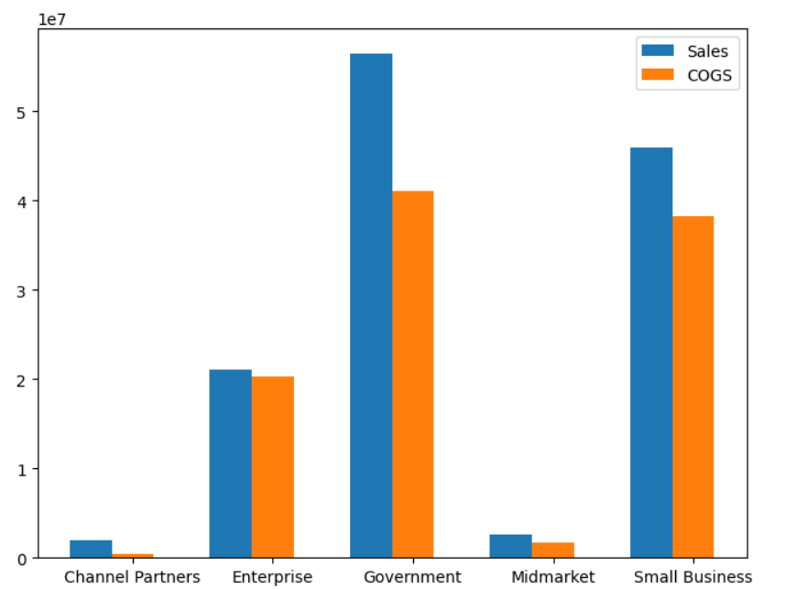
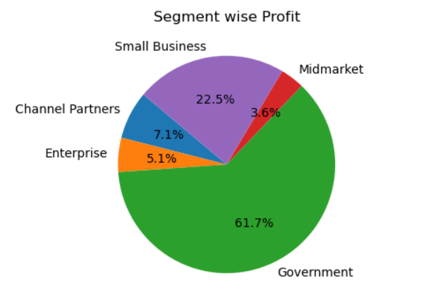
Sector Wise Analysis
Government segment gives most profit and Midmarket gives least profit
In the Enterprise sector cost of sales and sales is almost same so we can say that margin in that sector could be low and in government sector difference between Sales and COGS is more means this sector has more margin

Slide 12
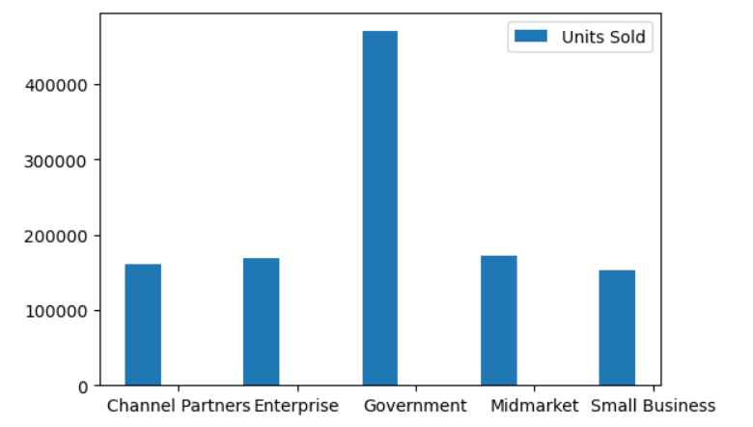
Sector Wise Analysis
More units are sold in government sector then mid market and least units are sold in small business

Slide 13
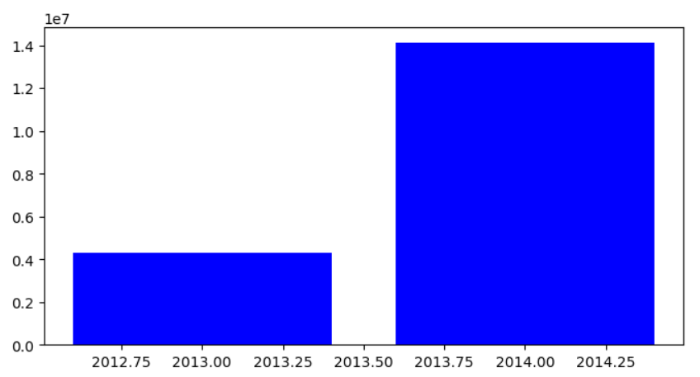
Profit Analysis By Year
More Profit is in year 2014 in compare to year 2013 & 2012

Slide 14

Recommendations
1) It is observed that the United States market demonstrates the highest sales figures yet the lowest profitability margins. To address this, it is recommended that a strategic review of expenditure be conducted with a view to trimming unnecessary costs, coupled with a focused investment in marketing initiatives to augment revenue streams.
2) Considering market performance metrics, it is advisable to consider the removal of Amarillo and VTT from the product portfolio, given their underperformance.
3) An imperative task lies in the enhancement of the Velo product line, which currently exhibits a marginally negative performance. Updates and improvements are warranted to rectify this issue.
4) Given the robust sales figures and evident demand for Paseo, a strategic imperative emerges to bolster Paseo production capacity to meet market demands effectively.

Slide 15

Thankyou
GitHub Link

